Slide 1
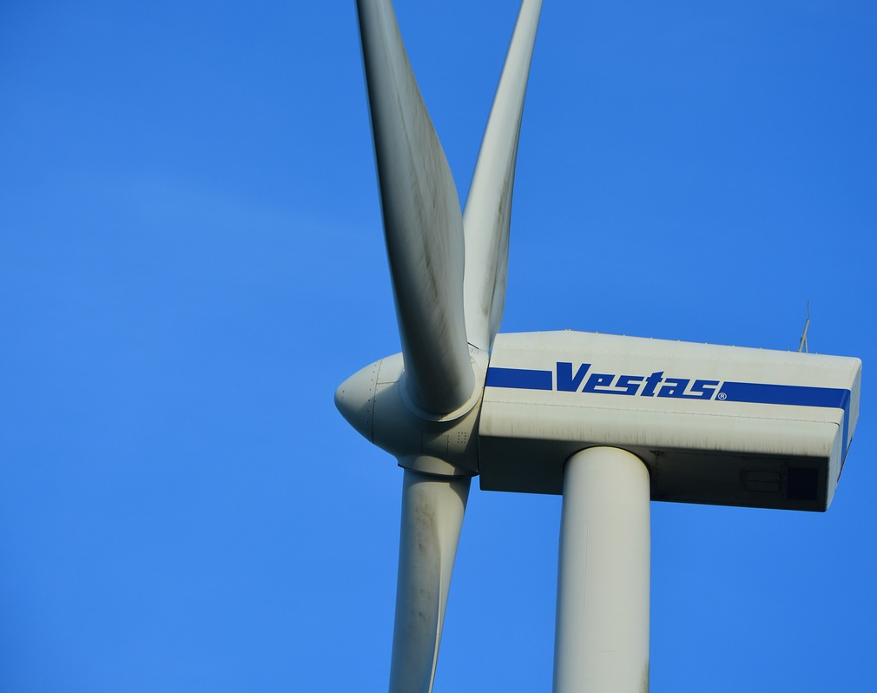
Maritime Wind Speed Prediction Using Buoy LIDAR Data
Team: Brian Waite, Carl Walenciak
Southern Methodist University
Time Series Analysis
Prof. B. Sadler

Slide 2
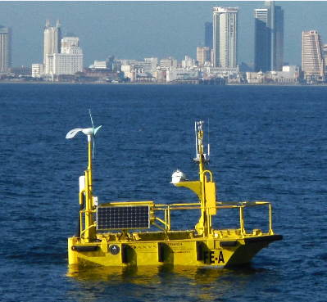
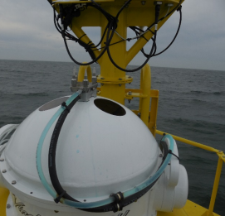
What is Buoy LIDAR Data?
Pacific Northwest National Labs (PNNL) in support of U.S. Department of Energy (DOE)
Buoy collects comprehensive meteorological and oceanographic data characterize offshore wind energy.
LIDAR – LIght Detection And Ranging
https://wind.pnnl.gov/lidarbuoyloanprogram.asp
https://wind.pnnl.gov/pdf/Example_Monthly_Report.pdf

